Slide 1
LaCarte Card Program
DeAnna Landry
Accounts Payable & Travel

Slide 2
LaCarte Card Program
The LaCarte card is available to employees for small dollar purchases and/or university travel expenses.
An approved LaCarte Enrollment form (AS700) should be submitted to request a LaCarte card.
Mandatory trainings must be completed to obtain a new or renewal LaCarte card.
Cards are distributed in Accounts Payable & Travel located in Room 217 Thomas Boyd Hall.
Cardholders are required to complete the 30-day reconciliation requirement.
Cardholder suspensions may be experienced for delinquent transactions.
The LaCarte card may not be used for personal purchases.

Slide 3
Annual Cardholder Review
Department Heads are required to conduct an annual review of their LaCarte cardholders.
A cardholder list has been sent to the Department Heads to review to spending limits and last usage date.
Card cancellations can be noted on the Annual Review report.
Cardholder profile changes will require the completion of the LaCarte Maintenance form (AS702).
October 15, 2024: Deadline to submit completed review to Accounts Payable & Travel

Slide 4
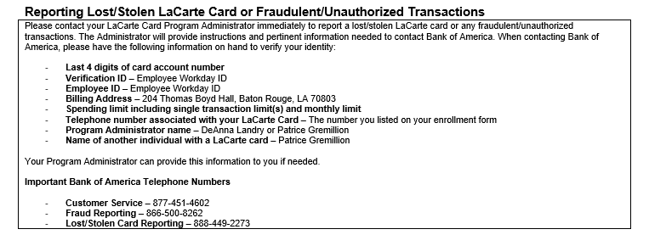
LaCarte Card Policy, PM-78, Appendix A
For convenience, the following information has been added to Appendix A of PM-78.
  Reporting lost/stolen cards or fraudulent transactions
  Important Bank of America telephone numbers

Slide 5
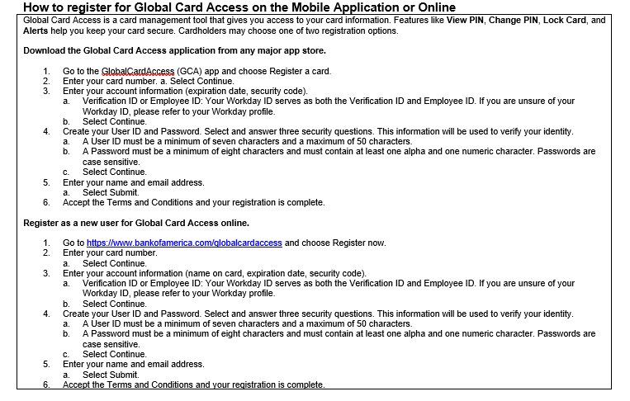
LaCarte Card Policy, PM-78, Appendix A
How to Register for Global Card Access on the Mobile Application or Online

Slide 6
LaCarte Card Policy Trainings
Fall 2024 Training Schedule (Zoom)
  09/19/2024: 9:00 AM
  10/17/2024: 1:00 PM
  11/14/2024: 9:00 AM
  12/05/2024: 1:00 PM
To register for a training, please go to LSU Training and Event Registration located on myLSU.

